Slide 1
Three Rivers District Council Housing Allocations Policy 2020 Consultation
Thursday, October 08, 2020

Slide 2
74
Total Responses
Date Created: Friday, September 04, 2020
Complete Responses: 74

Slide 3
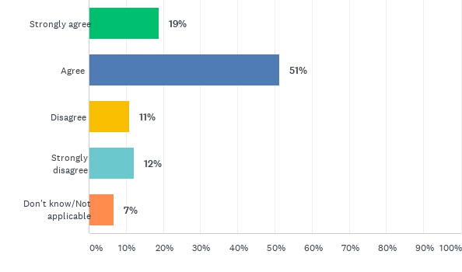
Q1: Currently, 'residency local connection' is established through current and five years continuous residence. The Council propose to change this to residency local connection criteria established through current residence and have lived in the District five out of six years (excluding time spent in temporary accommodation). The reason for this change is to allow customers a short time out of the District. Examples of this could be temporarily moving due to employment or to look after family members living in another local authority area.How strongly do you agree with the change detailed above?
Answered: 74 Skipped: 0

Slide 4
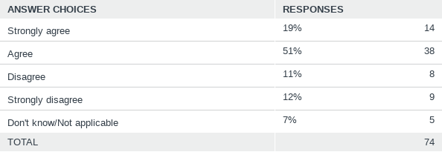
Q1: Currently, 'residency local connection' is established through current and five years continuous residence. The Council propose to change this to residency local connection criteria established through current residence and have lived in the District five out of six years (excluding time spent in temporary accommodation). The reason for this change is to allow customers a short time out of the District. Examples of this could be temporarily moving due to employment or to look after family members living in another local authority area.How strongly do you agree with the change detailed above?
Answered: 74 Skipped: 0

Slide 5
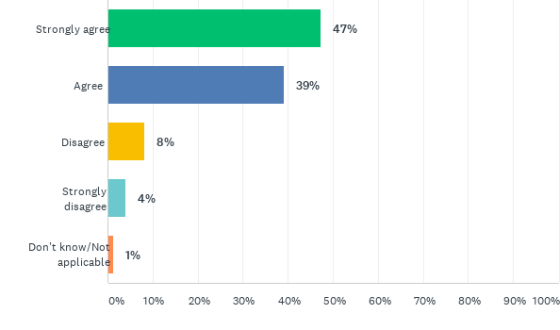
Q2: Currently, 'family local connection' is established where an immediate family member (parents, adult children, adult siblings) is currently resident and has continuously been a resident within the district for at least ten years. The Council do not propose to change this criteria, however the Council proposes the requirement for a customer to have a relationship with this family member and a need for support exists.This proposed change is designed to ensure there is a genuine need to move to the District for family support.How strongly do you agree with the change detailed above?
Answered: 74 Skipped: 0

Slide 6
Q2: Currently, 'family local connection' is established where an immediate family member (parents, adult children, adult siblings) is currently resident and has continuously been a resident within the district for at least ten years. The Council do not propose to change this criteria, however the Council proposes the requirement for a customer to have a relationship with this family member and a need for support exists.This proposed change is designed to ensure there is a genuine need to move to the District for family support.How strongly do you agree with the change detailed above?
Answered: 74 Skipped: 0

Slide 7
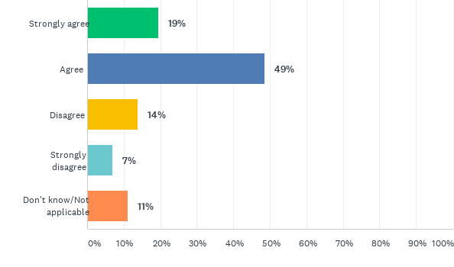
Q3: A local connection through employment is currently established if a customer is employed in the district (their main place of work is within Three Rivers) for at least 24 hours a week and for at least the last 12 months. The ‘Right to Move’ has been introduced by the Government and is designed to allow existing social housing tenants to move to another local authority area due to employment reasons or to take up an offer of employment where not being able to do so would cause hardship. The Council proposes to replace the employment local connection criteria with the ‘Right to Move’How strongly do you agree with the change detailed above?
Answered: 72 Skipped: 2

Slide 8
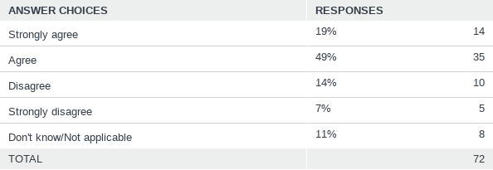
Q3: A local connection through employment is currently established if a customer is employed in the district (their main place of work is within Three Rivers) for at least 24 hours a week and for at least the last 12 months. The ‘Right to Move’ has been introduced by the Government and is designed to allow existing social housing tenants to move to another local authority area due to employment reasons or to take up an offer of employment where not being able to do so would cause hardship. The Council proposes to replace the employment local connection criteria with the ‘Right to Move’How strongly do you agree with the change detailed above?
Answered: 72 Skipped: 2

Slide 9
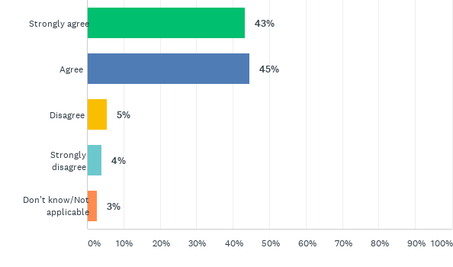
Q4: In many cases, victims of domestic abuse need to move away from the local authority area they are currently living in or have connections to. The Council proposes to exempt victims of domestic abuse from the local connection qualifying criteria. This is to ensure victims of domestic abuse are given the appropriate priority on the Housing Register and are not disadvantaged by the local connection criteria How strongly do you agree with the change detailed above?
Answered: 74 Skipped: 0

Slide 10
Q4: In many cases, victims of domestic abuse need to move away from the local authority area they are currently living in or have connections to. The Council proposes to exempt victims of domestic abuse from the local connection qualifying criteria. This is to ensure victims of domestic abuse are given the appropriate priority on the Housing Register and are not disadvantaged by the local connection criteria How strongly do you agree with the change detailed above?
Answered: 74 Skipped: 0

Slide 11
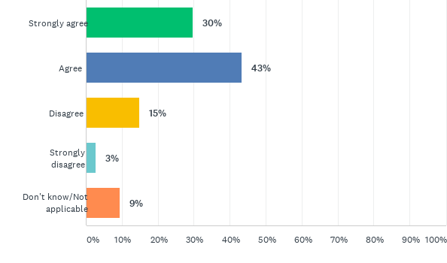
Q5: Currently the following groups of people are exempt from the 'local connection qualifying criteria':- a person having served in the Regular Forces;- a bereaved spouse or civil partner of someone having served in the Regular Forces, where the bereaved spouse or civil partner is no longer entitled to reside in military accommodation due and the death of their spouse or partner was whole or partly attributable to their service;- a person who is an existing or former member of the Reserve Forces and are suffering from a serious injury or illness which is wholly or partly attributable to their serviceFollowing Government guidance to ensure HM Forces personnel and family members are not disadvantaged from accessing social housing as a result of having served in the Forces, the Council propose that the following groups of people will be exempt from the local connection qualifying criteria:- a member or former member of the Regular Armed Forces and the application is made within five years of discharge (includes bereaved spouses and civil partners leaving service family accommodation provided by the Ministry of Defence following the death of their partner);- a divorced or separated spouse or civil partner of a Regular Armed Forces member who need to move out of accommodation provided by the Ministry of Defence due to relationship breakdown;- an adult child of a serving Regular Armed Forces member who is no longer able to remain in the family accommodation provided by the Ministry of Defence.How strongly do you agree with the change detailed above?
Answered: 74 Skipped: 0

Slide 12
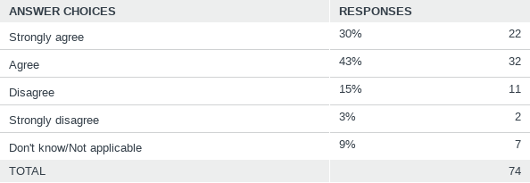
Q5: Currently the following groups of people are exempt from the 'local connection qualifying criteria':- a person having served in the Regular Forces;- a bereaved spouse or civil partner of someone having served in the Regular Forces, where the bereaved spouse or civil partner is no longer entitled to reside in military accommodation due and the death of their spouse or partner was whole or partly attributable to their service;- a person who is an existing or former member of the Reserve Forces and are suffering from a serious injury or illness which is wholly or partly attributable to their serviceFollowing Government guidance to ensure HM Forces personnel and family members are not disadvantaged from accessing social housing as a result of having served in the Forces, the Council propose that the following groups of people will be exempt from the local connection qualifying criteria:- a member or former member of the Regular Armed Forces and the application is made within five years of discharge (includes bereaved spouses and civil partners leaving service family accommodation provided by the Ministry of Defence following the death of their partner);- a divorced or separated spouse or civil partner of a Regular Armed Forces member who need to move out of accommodation provided by the Ministry of Defence due to relationship breakdown;- an adult child of a serving Regular Armed Forces member who is no longer able to remain in the family accommodation provided by the Ministry of Defence.How strongly do you agree with the change detailed above?
Answered: 74 Skipped: 0

Slide 13
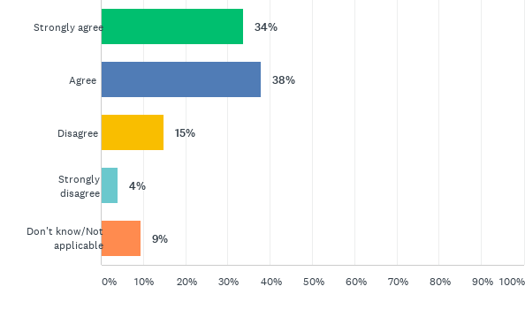
Q6: Following the introduction of the Council’s Housing Allocation Policy 2013, customers who did not meet the local connection criteria and registered prior to January 2013 could remain on the Housing Register, prioritised in Band D. The Council propose that only customers with a local connection as defined in Housing Allocations Policy 2020 will qualify to remain on the Housing Register.This proposal is made to ensure a consistent approach to all customers who have made an application to join the Housing Register, regardless of when an application was madeHow strongly do you agree with the change detailed above?
Answered: 74 Skipped: 0

Slide 14
Q6: Following the introduction of the Council’s Housing Allocation Policy 2013, customers who did not meet the local connection criteria and registered prior to January 2013 could remain on the Housing Register, prioritised in Band D. The Council propose that only customers with a local connection as defined in Housing Allocations Policy 2020 will qualify to remain on the Housing Register.This proposal is made to ensure a consistent approach to all customers who have made an application to join the Housing Register, regardless of when an application was madeHow strongly do you agree with the change detailed above?
Answered: 74 Skipped: 0

Slide 15
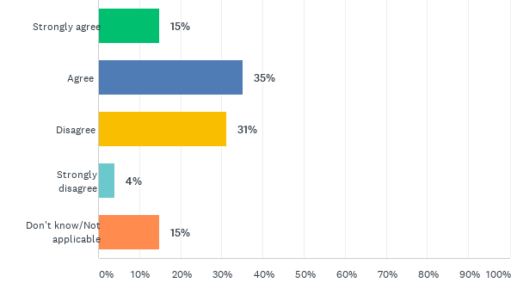
Q7: Currently, 'worker priority' (12 months band start date backdate) is awarded to customers who are currently employed for at least 24 hours a week and have been for 12 months. A couple making a joint application, their combined employment is 24 hours a week, to be eligible for 12 month back date.This worker priority remains but the Council propose that this working priority is awarded to customers who are unable to work due to illness or disability. How strongly do you agree with the change detailed above?
Answered: 74 Skipped: 0

Slide 16
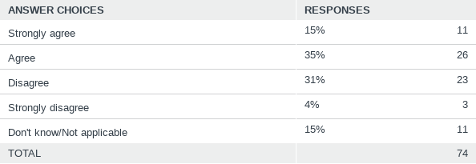
Q7: Currently, 'worker priority' (12 months band start date backdate) is awarded to customers who are currently employed for at least 24 hours a week and have been for 12 months. A couple making a joint application, their combined employment is 24 hours a week, to be eligible for 12 month back date.This worker priority remains but the Council propose that this working priority is awarded to customers who are unable to work due to illness or disability. How strongly do you agree with the change detailed above?
Answered: 74 Skipped: 0

Slide 17
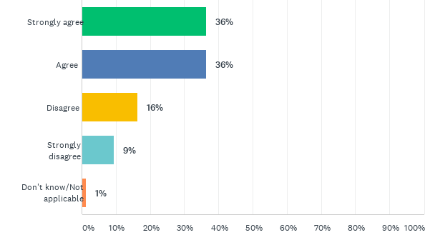
Q8: Currently an unborn child is not considered part of a customer’s household. The Council propose to change this to consider the unborn child as a member of the customer’s household four weeks prior to the estimated due date.This proposed change allows a customer to start bidding earlier for the property size they will need once an unborn child is born.How strongly do you agree with the change detailed above?
Answered: 74 Skipped: 0

Slide 18
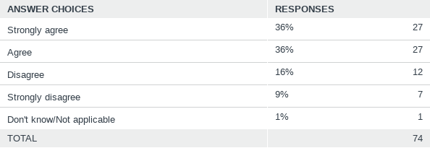
Q8: Currently an unborn child is not considered part of a customer’s household. The Council propose to change this to consider the unborn child as a member of the customer’s household four weeks prior to the estimated due date.This proposed change allows a customer to start bidding earlier for the property size they will need once an unborn child is born.How strongly do you agree with the change detailed above?
Answered: 74 Skipped: 0

Slide 19
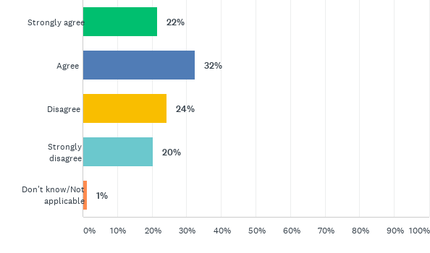
Q9: Currently customers with a gross income of over £35,000 annually are considered to have financial means to resolve their own housing need. To reflect the increasing property prices and typical private rented sector rent charge in the district, the Council propose to increase this figure to £60,000How strongly do you agree with the change detailed above?
Answered: 74 Skipped: 0

Slide 20
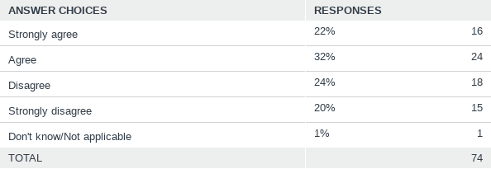
Q9: Currently customers with a gross income of over £35,000 annually are considered to have financial means to resolve their own housing need. To reflect the increasing property prices and typical private rented sector rent charge in the district, the Council propose to increase this figure to £60,000How strongly do you agree with the change detailed above?
Answered: 74 Skipped: 0

Slide 21
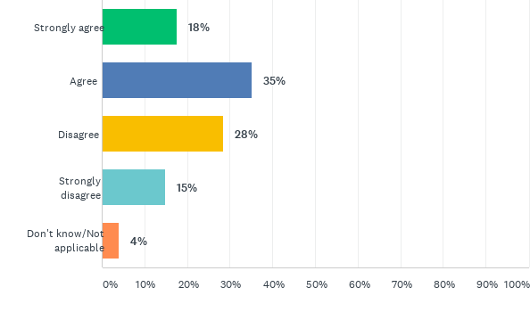
Q10: Historically Housing Register applications are verified at the point of application and the point of offer. A customer must provide all relevant documentation prior to being made live on the Housing Register.To improve officer efficiency the Council propose Housing Register applications are verified at the point of offer. Customers are requested to provide relevant documentation at the point of application, but this is not checked until a customer is nominated for a property.How strongly do you agree with the change detailed above?
Answered: 74 Skipped: 0

Slide 22
Q10: Historically Housing Register applications are verified at the point of application and the point of offer. A customer must provide all relevant documentation prior to being made live on the Housing Register.To improve officer efficiency the Council propose Housing Register applications are verified at the point of offer. Customers are requested to provide relevant documentation at the point of application, but this is not checked until a customer is nominated for a property.How strongly do you agree with the change detailed above?
Answered: 74 Skipped: 0

Slide 23
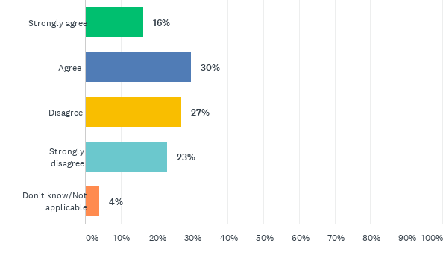
Q11: For clarity, a non-dependent child is typically considered a child who is over the age of 18 and no longer in secondary education (including sixth-form or college).Currently non-dependent children living with a customer are considered part of a customer’s household. The Council propose that these non-dependent children will now not be considered part of a customer’s household, unless they are unable to live independently due to care or support needs.This proposed change will allow the Council to make best use of the social housing stock in the District.How strongly do you agree with the change detailed above?
Answered: 74 Skipped: 0

Slide 24
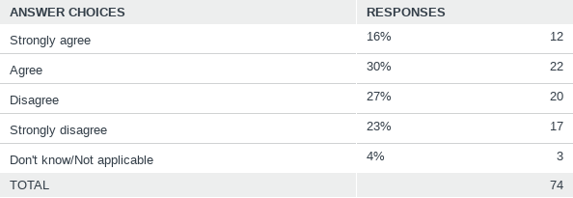
Q11: For clarity, a non-dependent child is typically considered a child who is over the age of 18 and no longer in secondary education (including sixth-form or college).Currently non-dependent children living with a customer are considered part of a customer’s household. The Council propose that these non-dependent children will now not be considered part of a customer’s household, unless they are unable to live independently due to care or support needs.This proposed change will allow the Council to make best use of the social housing stock in the District.How strongly do you agree with the change detailed above?
Answered: 74 Skipped: 0

Slide 25
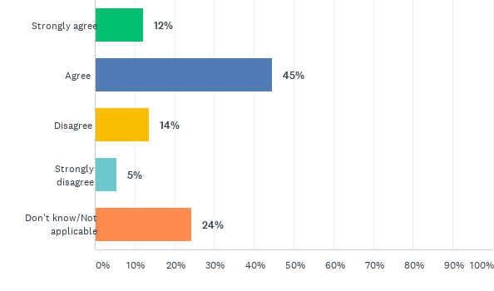
Q12: Currently certain groups of social housing tenants, living in a property smaller than their housing need, are awarded a five year backdate to their band start date. The housing need of customers in either tenure (social housing and private rented housing) does not differ, therefore the Council propose to remove this additional priority for these groups of social housing tenants.How strongly do you agree with the change detailed above?
Answered: 74 Skipped: 0

Slide 26
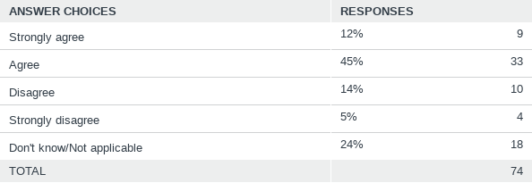
Q12: Currently certain groups of social housing tenants, living in a property smaller than their housing need, are awarded a five year backdate to their band start date. The housing need of customers in either tenure (social housing and private rented housing) does not differ, therefore the Council propose to remove this additional priority for these groups of social housing tenants.How strongly do you agree with the change detailed above?
Answered: 74 Skipped: 0

Slide 27
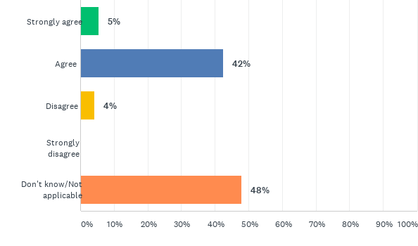
Q13: To recognise a customer is living in a property where a health and safety issue has been identified and raised with the landlord and to incorporate the new Prevent and Relief duties introduced in the Homelessness Reduction Act, the Council propose the following banding system changes:- Applicants living in accommodation and a hazard awareness notice has been served awarded Band D. - Customers owed a Prevention Duty awarded Band D. - Customers owed a Relief Duty with a priority need awarded Band C. - Customers owed a Relief Duty without a priority need awarded Band D. How strongly do you agree with the change detailed above?
Answered: 73 Skipped: 1

Slide 28
Q13: To recognise a customer is living in a property where a health and safety issue has been identified and raised with the landlord and to incorporate the new Prevent and Relief duties introduced in the Homelessness Reduction Act, the Council propose the following banding system changes:- Applicants living in accommodation and a hazard awareness notice has been served awarded Band D. - Customers owed a Prevention Duty awarded Band D. - Customers owed a Relief Duty with a priority need awarded Band C. - Customers owed a Relief Duty without a priority need awarded Band D. How strongly do you agree with the change detailed above?
Answered: 73 Skipped: 1

Slide 29
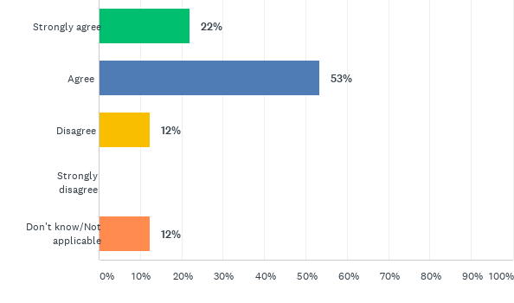
Q14: Composite needs recognises that a customer may have two separate housing needs of ‘equal priority’ which can result in having an overall greater housing need than another customer with just one housing need. Currently composite needs are not recognised by the Council’s banding scheme.The Council propose the introduction of composite needs, however one composite need must be medical priority. An example of composite needs is that a customer may be awarded Band C medical priority and Band C overcrowding priority. The current policy would award Band C priority; however composite needs recognises they have an overall greater priority and they would instead be awarded Band B priority.However customers with two separate Band B needs will not be awarded Band A. This is an acknowledgement that customers awarded Band A priority have an absolute urgent need to move. How strongly do you agree with the change detailed above?
Answered: 73 Skipped: 1

Slide 30
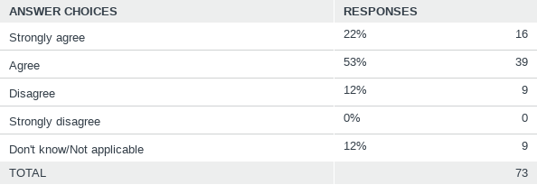
Q14: Composite needs recognises that a customer may have two separate housing needs of ‘equal priority’ which can result in having an overall greater housing need than another customer with just one housing need. Currently composite needs are not recognised by the Council’s banding scheme.The Council propose the introduction of composite needs, however one composite need must be medical priority. An example of composite needs is that a customer may be awarded Band C medical priority and Band C overcrowding priority. The current policy would award Band C priority; however composite needs recognises they have an overall greater priority and they would instead be awarded Band B priority.However customers with two separate Band B needs will not be awarded Band A. This is an acknowledgement that customers awarded Band A priority have an absolute urgent need to move. How strongly do you agree with the change detailed above?
Answered: 73 Skipped: 1

