Slide 1
Levelling Up (and Shared Prosperity Fund)
Member Briefing

Slide 2
Aims of the briefing
Brief Members on the key announcements and themes arising from Government's recently published Levelling Up White Paper
Identify implications for Three Rivers and update Members on information relating to next steps (where known).
Brief members on the latest information relating to the UK Shared Prosperity Fund and initial discussions from CMT.
Notes:
What is Levelling Up? (From the White Paper Summary)
‘This contemporary Medici model, our twenty-frst century recipe for a new Industrial Revolution, depends on harnessing an array of interventions and catalysing a range of sectors. Levelling up will require us to: a. boost productivity, pay, jobs and living standards by growing the private sector, especially in those places where they are lagging; b. spread opportunities and improve public services, especially in those places where they are weakest; c. restore a sense of community, local pride and belonging, especially in those places where they have been lost; and d. empower local leaders and communities, especially in those places lacking local agency. Levelling up is not about making every part of the UK the same, or pitting one part of the country against another. Nor does it mean dampening down the success of more prosperous areas. Indeed, by extending opportunity across the UK we can relieve pressures on public services, housing and green felds in the South East
What are the factors that will help drive levelling up? Levelling up requires a focused, long-term plan of action and a clear framework to identify and act upon the drivers of spatial disparity. Evidence from a range of disciplines tells us these drivers can be encapsulated in six “capitals”. • Physical capital – infrastructure, machines and housing. • Human capital – the skills, health and experience of the workforce. • Intangible capital – innovation, ideas and patents. • Financial capital – resource.s supporting the fnancing of companies. • Social capital – the strength of communities, relationships and trust.’ Institutional capital – local leadership, capacity and capability

Slide 3
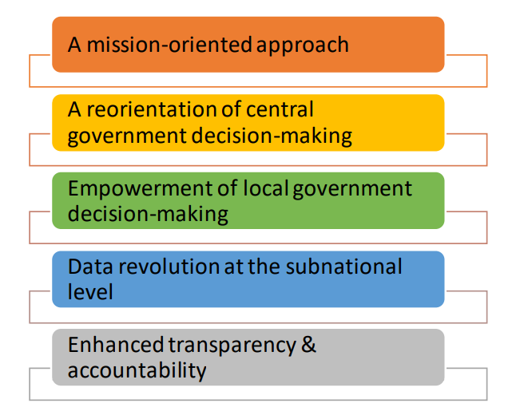
Levelling Up – 5 Pillars
Notes:
1. First, the UK Government is setting clear and ambitious medium‑term missions to provide consistency and clarity over levelling up policy objectives. These will serve as an anchor for policy across government, as well as catalysing innovation and action by the private and civil society sectors’. Here for Three Rivers we need to think about the impact on our own Policy – we have the Corporate Framework and the Community Strategy coming up for review this year.
Digital Connectivity, Education, Skills, Health, Wellbeing, Pride In Place, Housing, Crime, Local Leadership
2. Second, central government decision‑making will be fundamentally reoriented to align policies with the levelling up agenda and hardwire spatial considerations across Whitehall.
3. Third, the UK Government will empower decision‑makers in local areas by providing leaders and businesses with the tools they need. A new framework will extend, deepen and simplify local devolution in England.
4. Fourth, the UK Government will transform its approach to data and evaluation to improve local decision-making. – Could be quite beneficial in Three Rivers to have real local level data – though interesting to see how different this will be.
5. Fifth, the UK Government will create a new regime to oversee its levelling up missions, establishing a statutory duty to publish an annual report analysing progress and a new external Levelling Up Advisory Council

Slide 4
The 12 Missions

Slide 5
UK Shared Prosperity Fund
£2.6bn UK Shared Prosperity Fund then £1.5bn a year by 2024-25
In 2022-23 and 2023-24: interventions to strengthen pride in place
From 2024-25: further emphasis on investment to support life chances and skills, including for those furthest from the labour market
Most funding will be allocated to lower-tier local authorities.
Local areas will have the option to come together to deliver in places where there is an established history of collaboration between Las. (encouraged)
Local insight and collaboration with stakeholders, including MPs is key
Will need to develop an Investment Plan (over 3 years) to be submitted for Government approval in the Summer
Notes:
The £2.6bn UK Shared Prosperity Fund will be used to restore local pride across the UK by focusing investment on three main areas for investment: improving communities and place, people and skills, and supporting local business.
Worked out by a formula, funding allocated to district councils.
Main Aims:
Boost productivity, pay, jobs and living standards, especially in those places where they are lagging.
Spread opportunities and improve public services, especially in those places where they are weakest.
Restore a sense of community, local pride and belonging, especially in those places where they have been lost.
Empower local leaders and communities, especially in those places lacking local agency
.Instead, local leaders will be empowered to direct funding towards their own, locally identified priorities, whether that be promoting new outdoor markets, reducing litter, grafti and anti-social behaviour, reviving high streets, supporting local businesses or introducing skills provision to match local labour market need and support those furthest from the labour market.
Restoring Local Pride
Community Involvement/Local Leadership
Possible joining up with Watford/Hertsmere. Though there is a need to focus on inequalities which are often at lower ward level as well.
Mix of revenue and capital funding can be used to support a wide range of interventions to build pride in place and improve life chances. These can complement larger-scale Levelling Up Fund or Community Ownership Fund capital projects.

Slide 6
Three Rivers DC Initial Ideas
What are our investment priorities?
• Community and Place, Pride.
Local Community Engagement, Voluntary Sector key, Empowerment – communities and local leaders
ASB and serious violence, Parks and Open Spaces, Community Projects improving spaces creating ownership.
Improvements to the built environment – cycle routes, EV opportunities, links to local plan.
Health Inequalities, Hubs and access to services improving wellbeing. Links to Local Nature Recovery Strategy,
Notes:
To access allocation, each place will be asked to set out measurable outcomes they are looking to deliver, and what interventions they are choosing to prioritise in an investment plan. These will be submitted this summer for UK Government approval.
Ideas DO need to link up with other national schemes.
Flexibility to invest across a range of activities that represent the right solutions to improve local pride in place, help spread and create opportunity, and a sense of community and belonging. (Could think about including building on the new Community Wealth Project – the one led by Stevenage)
We should think about consulting the community on these ideas or priorities – what do people want to see to include in our plan. There is also emphasis on Local Partnerships – The LSP will be a key tool for this.
Where we have less ideas or opportunities I’d say is in the skills section. – what is our skills shortage – what does the economic strategy show?
Need to take account of other local and national policies and priorities – including the government’s commitment to reach Net Zero by 2050.
There will be funding for us to administer the fund (important to note as we have been juggling these other large funds and this will be important to ensure its implemented)

Slide 7
Three Rivers DC Initial Ideas
• Supporting Local Businesses
Building on Additional Restrictions Successful Projects – Sustainability in Businesses – energy efficiency and low carbon technologies
High Street Improvements – also supporting pride in place.
Work with the Growth Hub.
Heritage – Our Parks and working closely with the Museums building on previous work and creating jobs and pride.
• People and Skills
ARG Job Clubs, Film Industry. Adult Learning e.g work with ASCEND.
Growth Hub/LEP, Community Wealth Building Project.
Notes:
Economic development – Economic Strategy and Action Plan – these relate directly to this can use that in the plan. Economic Specialist and business comms officer.

Slide 8
Other Funds
1. The Levelling Up Fund
➢ £4.8bn over the period to 2024-25
➢ Targeted investment in capital infrastructure
2. The Towns Fund
➢ Town Deals – all announced, totalling £2.3bn
➢ The Future High Streets Fund - 72 places will share over £830m
Notes:
Next Steps Levelling up is a long-term endeavour. It is a programme of change that requires a fundamental shift in how central and local government, the private sector and civil society operate. The UK Government will embark on a process of sustained and systematic engagement and consultation with a wide range of stakeholders, including devolved administrations, on the White Paper. We will be setting out further detail on a number of these policy commitments in future publications. In addition, we will introduce legislation to Parliament to underpin in statute the changes fundamental to levelling up, alongside wider planning measures. This White Paper is the catalyst for delivering a long-term programme of change to unlock the potential of people and places in every part of the UK. This will create jobs, drive productivity, improve people’s quality of life and help restore their pride in the places where they live.

Slide 9
Next Steps
Policy Alignment – Corporate Framework/Community Strategy Review?
Development of UK Shared Prosperity Fund Investment Plan – Submission Summer?
-February and March - webinars and engagement activities with local authorities week commencing 7 February 2022
- Early conversations about how the Fund can best support the people and businesses in their community to thrive and grow.
Identifying local partners and stakeholders who can provide advice and insight on local needs
Identify key stakeholders and groups (LSP)
Community Engagement.
Levelling Up Fund - Growth Board/Districts/HCC?
Other Funding Opportunities – Safer Streets/Parks Fund?

Slide 10
The 12 Missions – More Detail

Slide 11
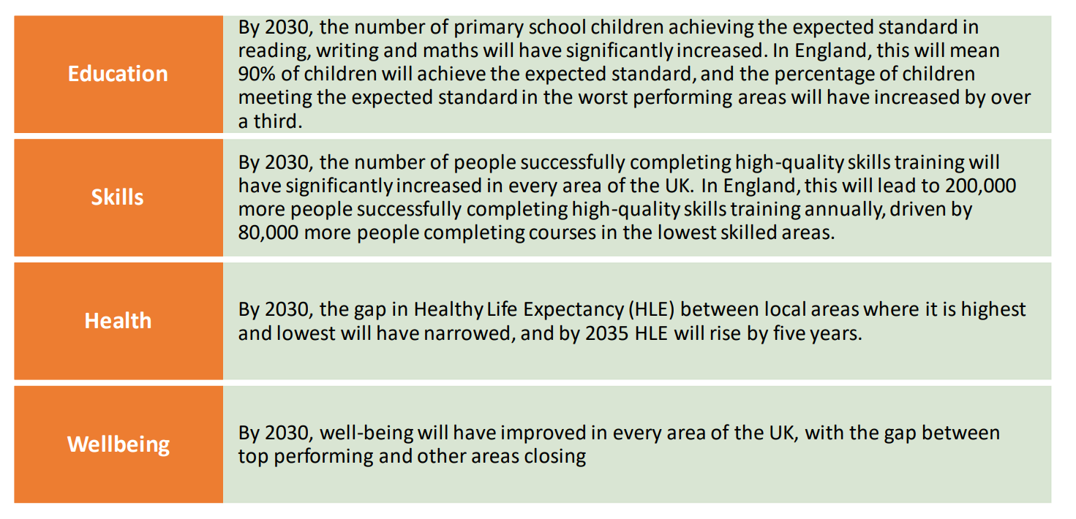

Slide 12
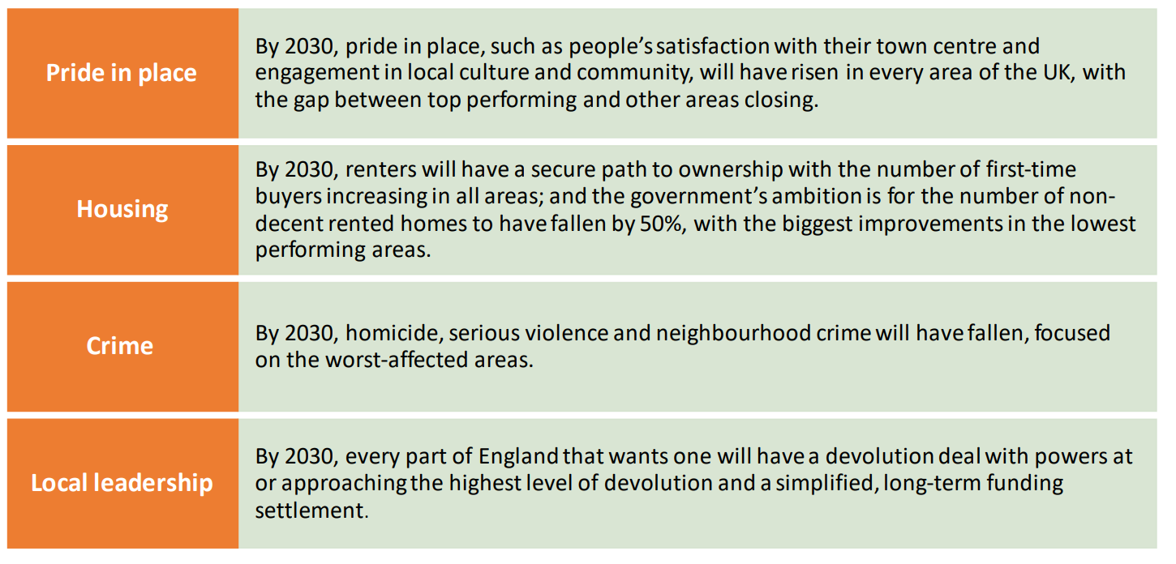

Slide 13
Crime
Noise complaints
Police in England and Wales will have the same powers to deal with noise complaints as are already available in Scotland.
LAs will retain the statutory responsibility for dealing with noise nuisance, but police officers also to have effective tools for tackling incidents which constitute crime and anti-social behaviour.
Anti-social behaviour
A new plan to assure communities that the government effectively tackles the perpetrators
Plans for a National Spring Clean - cleaning up neighbourhoods from litter, graffiti, and broken window
The Police, Crime, Sentencing and Courts Bill
A new legal duty for Local Government to work with partners to prevent and tackle serious violence
Safer Streets Fund
Three £50m rounds of funding from 2022-23 to 2024-25.
Primary objectives to be expanded to encompass the prevention of neighbourhood crimes e.g. burglary, robbery and vehicle theft, anti-social behaviour and violence against women and girls
Matched funding will be required from PCCs and LAs - £1 for every £2 the Government provide
Notes:
Interesting opportunities for bidding for Safer Streets funds if expanding
Also requirement around Serious Violence – could be ahead here with our serious violence strategy and No More project work.

Slide 14
Health & well-being

Slide 15
Pride in place

Slide 16
Skills

Slide 17
Digital connectivity

Slide 18
Education

Slide 19
Housing
A White Paper on renting – to be published in the spring
End the “no-fault” Section 21 evictions to end
A new minimum standards for rented homes
A National Landlord Register and tough measures against rogue landlords
A review of the Decent Homes Standard – to ensure it applies across all rented tenures. A consultation to follow A Social Housing Regulation Bill
Performance information for residents Older people in poor quality housing
A New Task Force to look at ways to increase the choices available
A new infrastructure levy to enable LAs to capture value from development more efficiently, secure
Enhancement of the LAs’ compulsory purchase powers to support town centre regeneration and provide further support for re-using brownfield land for development

Slide 20
Housing - Home ownership
£1.8bn investment in brownfield and infrastructure projects (the majority will be sites outside London and the South East)
A review of how to support councils to deliver greater numbers of council homes
Homes England to play a wider role in supporting mayors and LAs to build new affordable housing
New powers for councils to apply a premium of up to 100% to homes left empty for a year, rather than two years
Councils will retain all additional revenues to deal directly with the impacts of empty homes
The Government will consult on updated guidance on application of the empty
homes premium and possible statutory exemptions.

