Slide 1
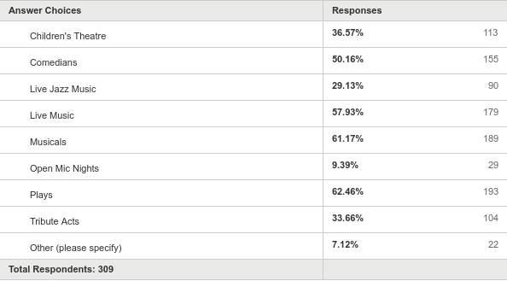
Watersmeet is looking to expand its programme. Which of these events would you come to at Watersmeet? (tick all that apply)
Answered: 309 Skipped: 3

