Slide 1

District
Performance Update
March 2016
www.hertssafeguarding.org.uk

Slide 2

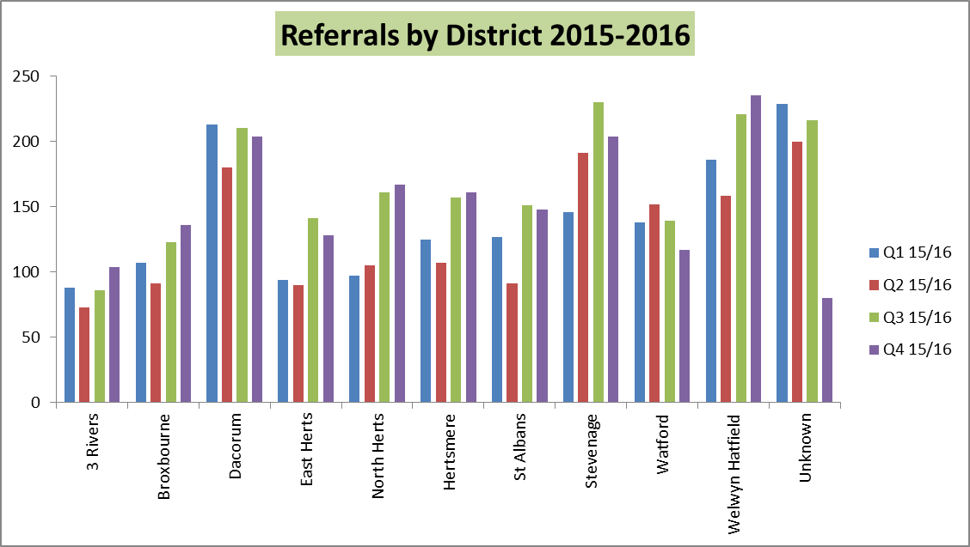
The total quarterly Referrals to Children’s Social Care are 1684
Data Source: Children’s Services Performance Report/LCS Dashboard

Slide 3
The total quarterly Referrals to Children’s Social Care are down from Dec 2015 to 1684 March 2016
Rates Per 10000 Highest Stevenage: 104.5
Lowest East Herts: 40.1
Data Source: Children’s Services Performance Report/LCS Dashboard
Notes:
Referrals for the whole county stand at 1684 for quarter 4 of 2015-16
Stevenage continues to have the highest referral rate despite the lowest population level of under 18’s.
Work has been continuing by the data team on eliminating cases with an unknown postcode.
Broxbourne 21617
Dacorum 33484
East Hertfordshire 31960
Hertsmere 23627
North Hertfordshire 28748
St. Albans 34297
Stevenage 19524
Three Rivers 20594
Watford 22859
Welwyn Hatfield 24036

Slide 4
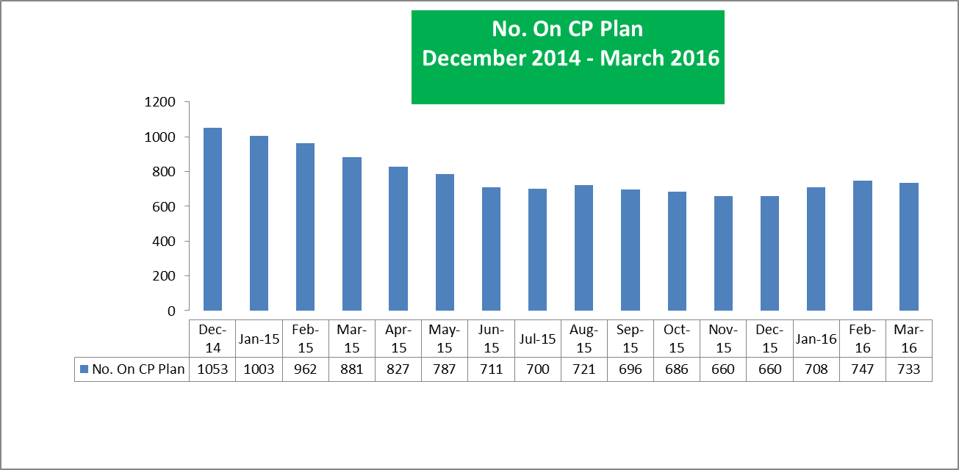
Child Protection plans In Place
March 2015 – 1140 CP Plans
June 2015- 711 CP Plans
Sept 2015 – 696 CP Plans
March 2016 – 733 CP Plans
Data Source: Children’s Services Performance Report/LCS Dashboard
Notes:
CPP - has increased over the last three months and now stands at 733. This is the first increase in figures this financial year. There continues a focus on reducing plans especially those children who had been on a plan for over a year and particularly those on a plan for over 2 years and whether they still meet the criteria for ongoing significant harm. The focus is on ensuring purposely intervention and stepping cases up when concerns persist and stepping down to CIN plans if risk.

Slide 5
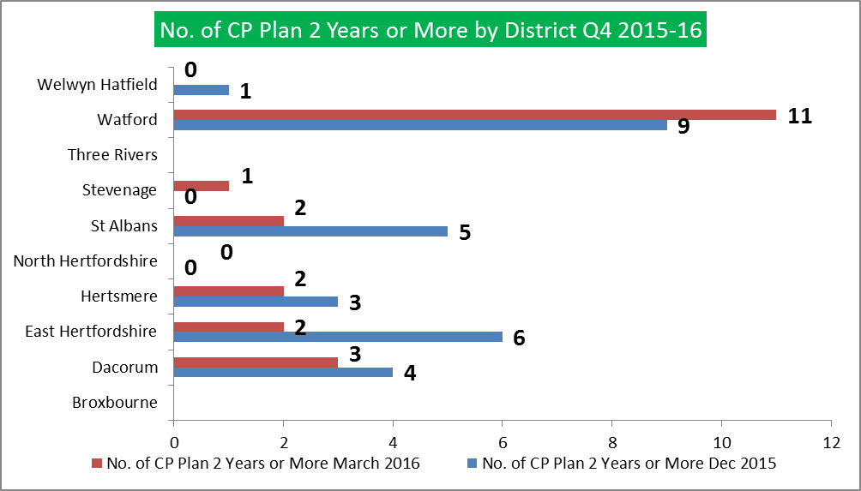
Quarter 4 15/16
Highest: Watford 11
Lowest: Broxbourne, Three Rivers and North Herts : 0
Notes:
Watford had the most children who have been on a plan for over 2 years – 11
Broxbourne and Three Rivers and North Herts have none.
These have fluctuated on the over the quarters but has decreased from a total of 42 in Quarter 1 2015-16, to 21 in Quarter 4.

Slide 6
Districts Breakdown CP Plans Second or Subsequent Time
Quarter 4 15/16
Highest: Welwyn Hatfield: 45
Lowest: North Herts: 7
Notes:
Welwyn Hatfield have the most children who have been on a plan for a second or subsequent time – 45.
The number of unknown stand at nine which are addressed through data housekeeping.
St Albans have 14 and Dacorum 17.

Slide 7
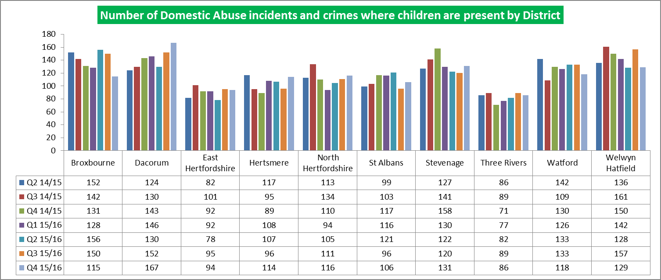
Q2 15/16
Highest: Dacorum : 167
Lowest: Three Rivers: 86
Data Source: Colin Grove HCC data return
Notes:
Dacorum had the highest number of domestic violence incidents and crimes where children were present in Q4 2015/16.
Consistently more than 120 children recorded each quarter are Dacorum, Stevenage, and Welwyn Hatfield
St Albans has increased in quarter 4 from 96 incidents to 106

Slide 8
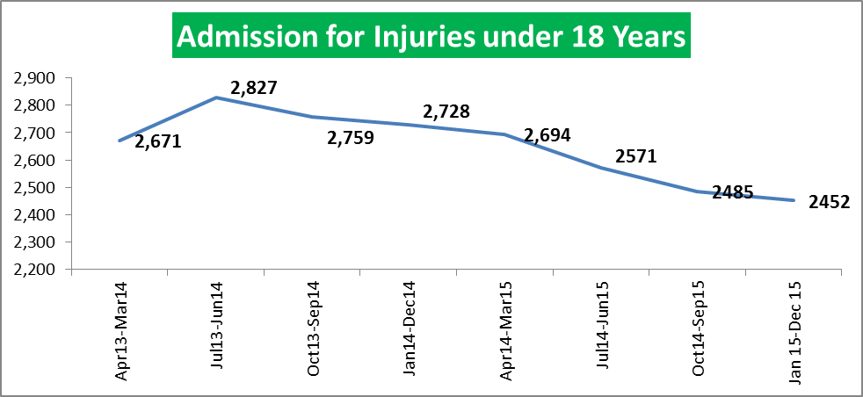
Hospital admissions for injuries
have decreased from 2485 in Q2 to 2452 in Q3.
Data Source: MedeAnalytics SUS data via HSCB
Notes:
There has been a slight decrease in hospital admissions for injuries rolling year on year and they reached 2452 in Quarter 3.

Slide 9
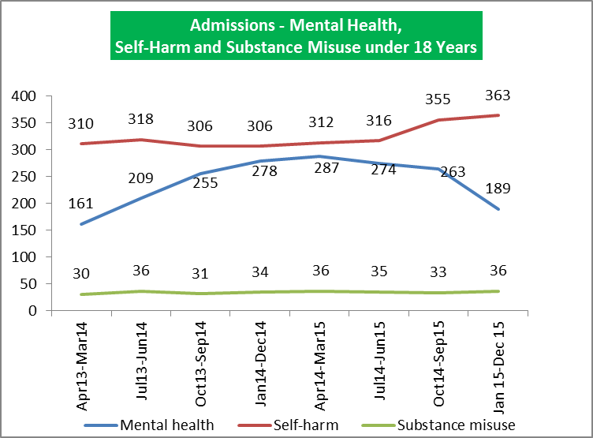
Hospital admissions for mental health
Have decreased to 189 in Quarter 3
Hospital admissions for self-harm
Have increased 363 in Quarter 3
Hospital admissions for substance misuse
Have increased slightly to 36 in Quarter 3
Data Source: MedeAnalytics SUS data via HSCB

Slide 10
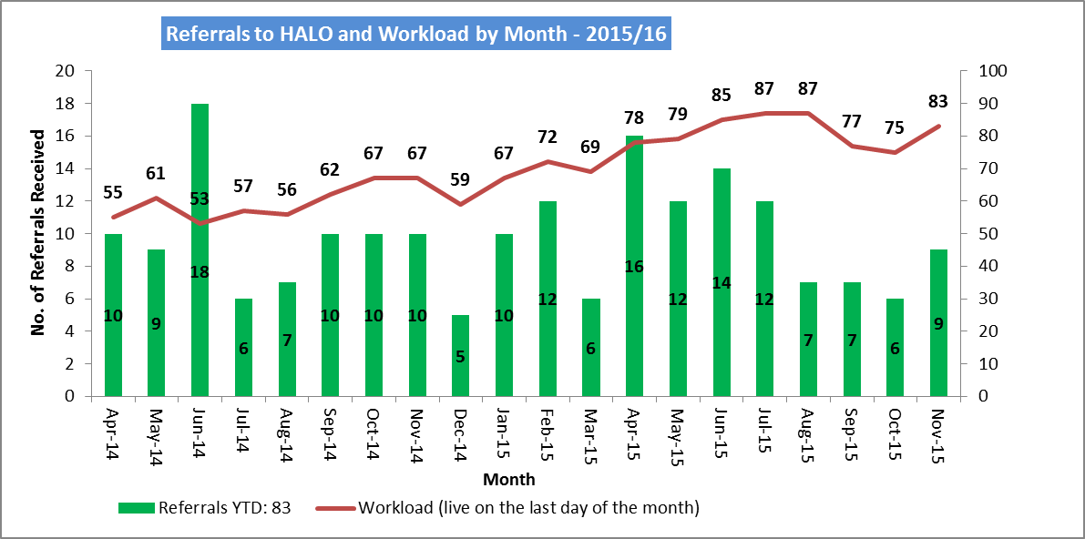
Referrals to HALO and Workload
Workload risen to 83 Cases – Nov 2015
Data Source: Kerry Biggadike Halo team
Notes:
The latest figures from the Halo team (up to the end Nov 2015), show an increase in the team’s workload to 83 cases. Referrals to the team have fluctuated over the past year, the range being between 5-18 (April 14-Nov 15).
The Board will continue to receive further updates on the team’s activities over the year.

Slide 11
END

